Slide 1
ME6491E COMPUTATIONAL LAB FOR ENERGY ENGINEERING
Introduction to Ansys Fluent – Simulation

Slide 2
What is Ansys?
Ansys is an engineering simulation software used to analyze and solve complex engineering problems through Computer-Aided Engineering.
Why Ansys ?
It allows engineers to simulate how a product will behave in the real world without physically building and testing it.

Slide 3
What Ansys can do?
Structural Analysis – stresses, deformation, vibration etc.
Fluid Dynamics – liquid flow, turbulence etc.
Thermal Analysis – heat transfer, temperature effects etc.
Electromagnetics – electric/magnetic field simulations
Multi-Physics – combined effects (e.g., fluid-structure interaction)

Slide 4
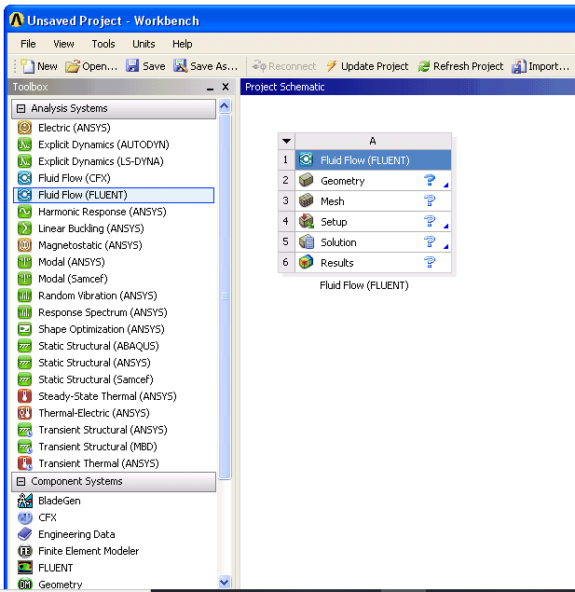
Ansys Workbench
Integrated platform for engineering simulation
Combines CAD, pre-processing, solving, and post-processing
User-friendly drag-and-drop interface
Widely used in industries: automotive, aerospace, energy, etc.

Slide 5
What is Ansys Fluent?
ANSYS Fluent is a Computational Fluid Dynamics (CFD) software used to simulate fluid flow, heat transfer, turbulence, chemical reactions, etc.
It solves governing equations associated with a fluid flow such as continuity equation, momentum equation and energy equation.

Slide 6
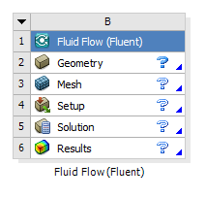
General Workflow in Fluent
1. Geometry Creation
2. Meshing
3. Setup
4. Solution
5. Postprocessing

Slide 7
Geometry Creation
The required geometry is created in this section and dimensions are given
Use ANSYS SpaceClaim, DesignModeler, or import geometry from CAD software.
Geometry must be in such a way that fluid regions are clearly defined.
2. Meshing
Meshing divides the domain into small control volumes.
Types of mesh: structured, unstructured, tetrahedral, hexahedral, etc.
Finer mesh → more accurate results (but increased computation).
Giving names to required parts could be done in this section

Slide 8
3. Setup
Define physics models:
  Solver type: Pressure-based or Density-based
  Flow type: Laminar or Turbulent
  Energy equation (if heat transfer is involved)
  Multiphase, species transport, etc. if needed.
Set material properties (fluid, solid).
Set boundary conditions (inlet, outlet, wall, symmetry).
Initialize the solution.

Slide 9
4. Solution
Choose solution methods (e.g., SIMPLE- Semi-Implicit Method for Pressure-Linked Equations, PISO-Pressure Implicit with Splitting of Operators).
Run iterations and monitor residuals.
Check for convergence (residuals drop below threshold, monitor variables stabilize).
5. Postprocessing
Use contour plots, velocity vectors, streamlines, temperature plots, etc.
Evaluate important parameters: pressure drop, heat flux, drag force, etc.

Slide 10
Important Concepts
Terms | Description
Cell Zone | Region of the mesh assigned to a specific material.
Boundary Condition | Specifies how the fluid interacts with the boundaries (e.g., velocity inlet, pressure outlet, no-slip wall).
Turbulence Models | Used when simulating turbulent flow (e.g., k-ε, k-ω).
Residuals | Measure of solution error – must reduce to indicate convergence.
CFD Post | Tool to visualize simulation results.

Slide 11
Common Errors to Avoid
Poor mesh quality → affects accuracy and convergence.
Incorrect boundary conditions → unrealistic results.
Forgetting to turn on physical models (e.g., energy equation for heat transfer).
Not checking units consistently.

Slide 12
List of Computational Experiments
Fluid flow and heat transfer in a mixing elbow-pipe and comparison of accuracies of discretization schemes
Flow past a cylinder
Heat transfer in a concentric pipe
Velocity boundary layer flow over a flat plate
Unsteady heat transfer from suddenly dropped hot square plate or slab in cold water

Slide 13
THANK YOU

